Slide 1
Prediction of Cancellations in Hotel Reservations for Operational Optimization
Andrés Padrón Quintana
Guillermo Palestino Martínez
Cuahtemoc Maya Maldonado
Gabriel Ángel Laurel Membrillo
Data-Driven Business Decisions

Slide 2


Slide 3

Why cancellations are a problem?
Cancellations cause:
Daily actualized income to drop below projections when rooms cannot be re-booked.
Forced price reduction to fill vacancies.
Increased distribution costs to sell those vacant rooms.

Slide 4
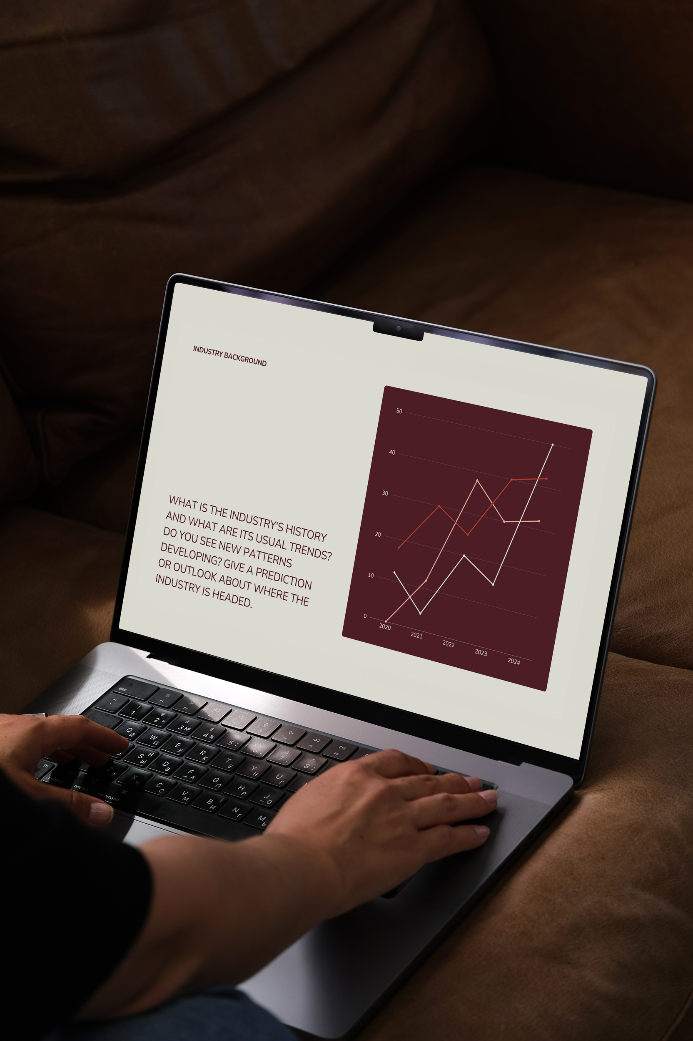
Predicting cancellations to decrease uncertainty and increase revenue
Objectives:
Identify the factors that predict booking cancellations.
Propose data-driven strategies to reduce cancellations.
Design a predictive model to anticipate cancellations, enabling the hotel to optimize occupancy and increase revenue.

Slide 5
Data and Variables
Observations: 120 000 reservations (2015–2017)
Hotel Type: City and Resort
Key Variables:
lead_time: Days between booking date and arrival date
total_stays: Total nights booked
booking_changes: Number of changes made to the booking
previous_cancellations: Previous cancellations by the customer
hotel: Type of hotel (Resort or City)
deposit_type: Type of deposit (None, Refundable, Non-Refundable)
is_repeated_guest: Whether the customer has previously visited the hotel
customer_type: Customer classification (Contract, Group, Transient, or Transient-Party)
market_segment: Booking channel (Direct, Corporate, Online, etc.)
arrival_date: Arrival date (year, month, and day)

Slide 6
City vs Resort
Feature | City Hotel | Resort Hotel
Location | Urban centers, business districts | Tourist destinations, beaches, countryside
Main Purpose | Business trips, short-term stays | Leisure, vacations, family or couple getaways
Booking Lead Time | Shorter, often last-minute | Planned in advance
Customer Profile | Business travelers, solo travelers | Families, couples, groups

Slide 7
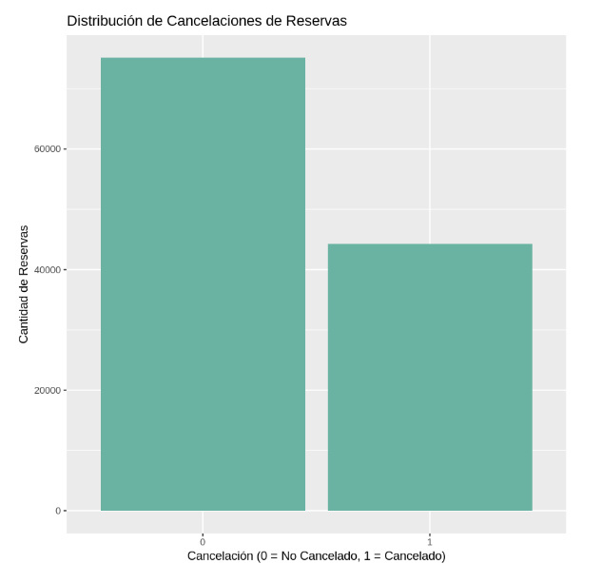
37% of the reservations were canceled
Cancellations are a significant problem for the hotel. This proportion suggests that there is enough information to identify patterns that can help predict and prevent future cancellations.

Slide 8
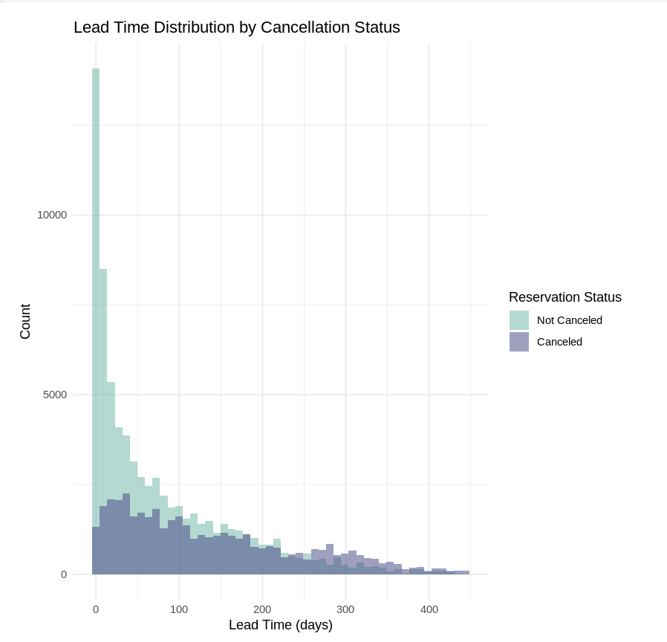
Cancellations tend to have a significantly higher lead time compared to non-canceled bookings.
Customers who booked closer to the arrival date were much more likely to show up.
Bookings made well in advance had a higher probability of cancellation.
Overlap exists, but the distribution differs clearly:
Long lead time → Higher cancellation risk.
Short lead time → Lower cancellation risk.

Slide 9

Data Cleaning
Elimination of Null Values:
company and agent columns were removed due to too many null values.
Elimination of Irrelevant Data:
name, phone_number, and credit_card were removed due to a lack of predictive value.
Conversion of Categorical Data:
Categorical variables were converted into factors for compatibility with R models..
Creation of New Variables:
total_stays and total_guests were created to improve the predictive capability of the model.

Slide 10
New Variables
New Variable | Description | Reason for Creation
total_stays | Sum of stays_in_week_nights and stays_in_weekend_nights | Captures the total length of stay in a single variable
total_guests | Sum of adults, children, and babies | Reflects total group size, which affects cancellation behavior
is_canceled (factor) | Recoded from 0/1 to “Canceled” and “Not Canceled” for interpretability | Improves visualization and model output clarity
lead_time (numeric) | Converted to numeric type (if factor) to allow calculations and binning | Enables quantitative filtering and plotting

Slide 11
Model | Accuracy | Sensitivity | Specificity | Key Takeaway
Logit | 0.762 | 0.979 | 0.393 | Good at detecting non-cancellations, poor specificity
Probit | 0.758 | 0.979 | 0.383 | Similar to Logit, slightly worse performance
Random Forest | 0.771 | 0.389 | 0.996 | Excellent at confirming bookings, misses few cancellations
Predictive Models
Random Forrest is the best one:
RF is the most accurate in predicting for cancelled bookings
RF has a higher specificity, so it has a lower type I error rate.

Slide 12
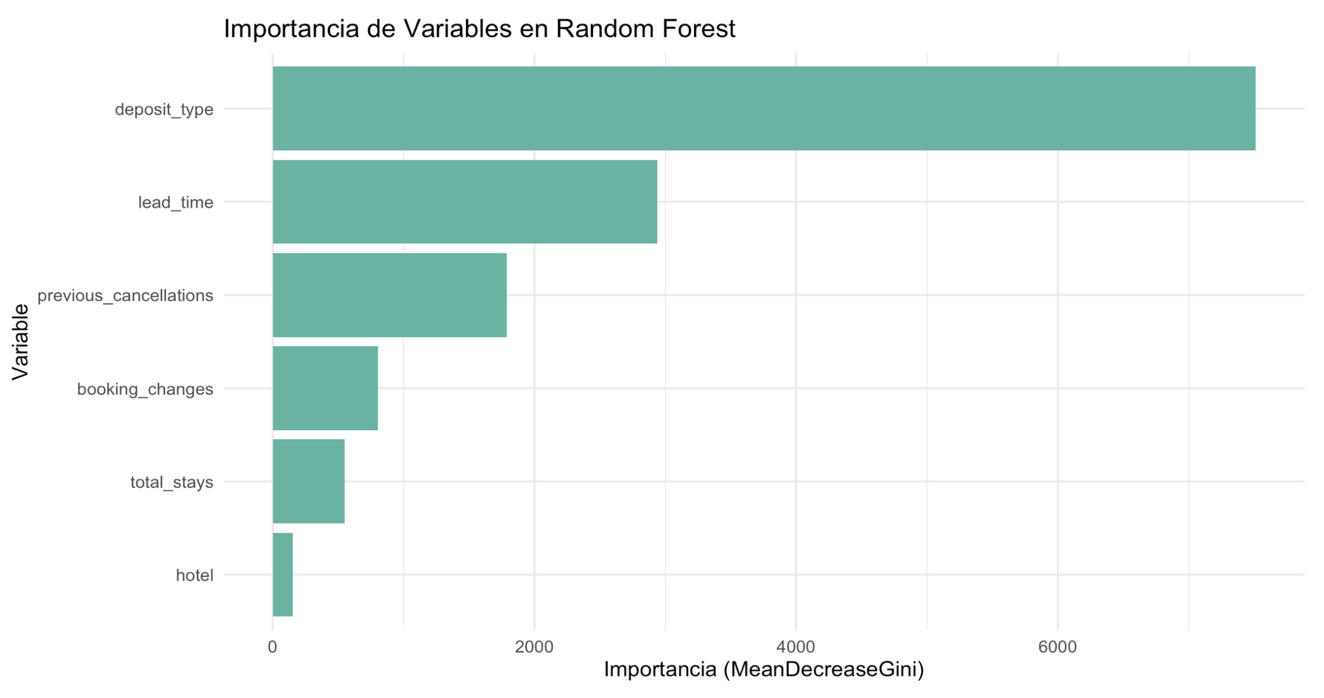

Slide 13
Key Factors
Deposit Type: Non-refundable deposits reduce cancellations.
Previous Cancellations: Customers with a history of cancellations are more likely to cancel again.
Lead Time: Reservations made well in advance are more likely to be canceled.
Length of Stay: Longer stays have a lower probability of cancellation.
Booking Changes: A higher number of booking changes increases the risk of cancellation.

Slide 14
Economic Approach
Assuming the hotel processes 5,000 bookings per month and the average revenue per booking is $150
A 1% reduction in cancellations = 50 recovered bookings → $7,500 in additional revenue/month.
A 5% reduction = $37,500/month → Over $450,000/year in retained revenue.
Extra revenue from reservations that will not be canceled
Food and Beverage: Each reservation typically generates $30 to $50 per night in dining revenue.
Transportation and Tours: Those who book tend to spend $40 to $100 on transportation and local experiences.
Spa and Wellness: Non-canceled reservations can bring in $100 to $200 through spa services.
Room Upgrades: Early detection of likely cancellations allows hotels to reallocate premium rooms, potentially increasing revenue by $100 to $300 per reservation.

Slide 15
Scenario | EDA Only (Descriptive) | Random Forest (Predictive)
Current Cancellation Rate | 37% | 32% - 27% (expected 5-10% reduction)
Monthly Bookings | 5,000 | 5,000
Average Revenue per Booking | $150 per booking | $150 per booking
Monthly Revenue | $472,500 | 547,500
 | Extra revenues (commodities) | 62,500
 | Total monthly difference | 127,500 (1.27)

Slide 16
Why This Model Adds Business Value
Automated decision support: real-time cancellation predictions for operational planning.
Customers: personalize incentives for high-risk profiles.
Scalable: can be deployed across multiple hotel brands and locations.
Cost-saving potential: optimizes room inventory and staffing.
Actionable insights: identifies why customers cancel, not just who cancels.

Slide 17
Why Use Machine Learning for a “Simple” Cancellation Problem?
Traditional Approach | Machine Learning Approach
Manual review of bookings | Automated prediction at scale
Based on intuition or rules of thumb | Based on statistical patterns across 30+ variables
Difficult to adapt to changing trends | Continuously adaptable to new data
No quantification of cancellation risk | Outputs precise cancellation probabilities (e.g., 85%)
Limited to basic reports | Enables real-time alerts and strategic overbooking

Slide 18


Slide 19
References
Tudón Maldonado, J. (2025). Slides, Readings, and Data Lists. Dropbox. . (2025). Slides, Readings, and Data Lists. Dropbox. https://www.dropbox.com/scl/fi/c0doxdvcnclk46fh8n5us/slides_readings_and_data_lists.pdf?rlkey=hrtgbkvyzodqh3fav1xc86m03&e=2&dl=0
Mojtaba. (2022). Hotel Booking Demand Dataset [Dataset]. Kaggle. https://www.kaggle.com/datasets/mojtaba142/hotel-booking
Statista. (2023). Holiday Inn hotels gross revenue worldwide from 2009 to 2023. Retrieved from https://www.statista.com/statistics/223345/holiday-inn-hotels-revenue/

